Slide 1
MEASURE ENERGY CONSUMPTION

Slide 2
ABSTRACT;
The task of reducing the energy footprint of IT devices and software has been a challenge for Green
IT research. Monitoring approaches have primarily focused on measuring the energy consumption of
the hardware components of computing devices. The use of applications or software on our
computer systems consumes energy and it also affects how various hardware components and
system resources consume energy. Consequently, running web browsers applications will utilise
considerable energy and battery consumption. In this research, we have run different types of
experiments which involve the use of several measuring tools. Firsly, a joulemeter is used to monitor
(and measure) the power consumed by the hardware and software while running web-based and
stand-alone applications on several devices. Additionally, the tablet in-built battery status checker is
used to measure the battery consumption when web-based applications are run on the device.

Slide 3
Introduction;
Green computing technology focuses on the efficient use of computing resources. In computing
devices such as laptops, smartphones, tablets, or other mobile devices, energy consumption is the
top priority because they are run on battery, with limited lifespan, as their source of power
(Banerjee et al. 2007). With the increasing complexity of IT equipment, the energy consumption rate
of these devices system also increases (Silven and Jyrkka, 2007). Most portable mobile device users
are conscious of the energy usage by these devices and consequently, they look for ways through
which the lifespan of the battery can be extended to serve them longer

Slide 4
1.1 Aim
The aim of this paper is to discuss the results for several investigations conducted on the energy (and
battery) consumption for running web-based and standalone applications on Windows and IOS
portable computing devices. The following objectives will help to achieve this aim:
• Research Objective 1: To conduct experiments on the measurement of energy consumed for
running youtube videos in different web browsers (e.g. Google Chrome, Mozilla Firefox,
etc…) on Windows (i.e. laptops), and IOS machines (i.e. tablet);
• Research Objective 2: To conduct experiments on the measurement of energy consumed for
playing audio and video files on several media players for windows (on a laptop);
• Research Objective 3: To conduct analyses on data collected in Research Objectives 1 and 2.

Slide 5
Media players for windows
Media Players for Windows
To reiterate, the Joulemeter monitored raw data is for the time stamp (in ms), power consumption
(in Watts) for each component: CPU, monitor, disk, base and the application. The formula used to
calculate the energy consumption by each component is: Energy (J) = Power (W) x Time (s). The
results of the calculation for all the experiments runs are shown in Table 9. Normalised data for t =
1s is depicted in Table 10 in order to provide a fair comparison between the various media players.

Slide 7
Working principle;
Electricity meters operate by continuously measuring the instantaneous voltage (volts) and current (amperes) to give energy used (in joules, kilowatt-hours etc.). Meters for smaller services (such as small residential customers) can be connected directly in-line between source and customer.
What is the principle of energy consumption?
There is a tight bond between wealth and the primary commodities that give us things like light, heat and mobility; I call it the First Principle of Energy Consumption. It simply says that the more money a person makes, the more energy they use. The First Principle works in reverse too.
This paper will be organised into the following sections: Introduction; Literature Review; Methodology; Results and Discussion; and Conclusion.

Slide 8
Energy consumption of software;
Green and sustainable software is a software product that has the smallest possible economic, societal, ecological impact as well as impact on human beings (Ahmed, et al., 2014). This has led to the introduction of various programmes and initiatives that encourages energy efficient software such as green software engineering and Eco-design software (Kaliterre, n.d.).
According to the Greenhouse Gas Protocol (2012), applications are executed with an OS. They affect the power consumption of a device due to data requests and processing. Managing energy requires accurate measurement of the energy available and consumed by a system. This involves monitoring or estimating the resource and energy consumption of hardware and software (Noureddine, et al., 2013). However, a device’s power consumption is subjected to the type of application and the task being performed which is evident in our experimental results presented in Section 4 of this paper. In order to reduce the overall power consumption for a web-based or standalone task, it will be necessary to provide users with an insight of the power consumption of the different web-based browser applications (e.g. Google Chrome, Internet Explorer, Mozilla Firefox, Safari, etc…) and also the resource hungry nature of many applications such as movie player and games.

Slide 9
Data preprocessing;
By the developments on the measurement and communication infrastructures in power systems, it has become possible to collect data from more points and with higher resolutions compare to the past. Increasing data volume, on the one hand, increases the quality of the information possessed, on the other hand, it has made the processing of data more complicated. With the increase in data volume, the size and variety of data quality problems has also increased. The success of data analysis is closely related to data quality. In order to obtain consistent results, missing or outlier data must be determined and removed from the data sets, and the data should be formatted in accordance with the study. All processes applied for this purpose are called data preprocessing. The data preprocessing is examined under four main headings.

Slide 10
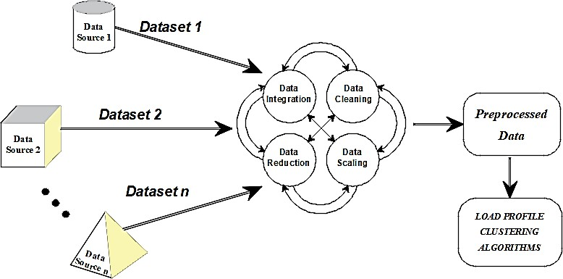

Slide 11
Data integration ;
In general, electrical energy consumption clustering studies are based on consumption data only. However, in some studies, various data affecting electricity consumption can also be included in the analysis. In such multivariate studies, different data sets should be combined and analyzes should be performed on a single data set.
Different data storage mechanisms are used in data storage in order to use data space efficiently and to increase data speed. For this reason, data sets in different databases could be in different data architectures and encrypted. In addition, different formats can be preferred while storing data. In order to create a single usable data set from various databases created independently from each other, it is necessary to eliminate the differences between the data sets and bring them together under a standard structure. This process is called data integration].
Apart from the structural differences, the content of the data sets to be combined may also differ. Electricity consumption data are time series type data. The difference in the time intervals and resolutions of suchdata sets may cause dimensional incompatibility. On the other hand, not all of the features in a dataset content may be needed. The new data set to be created by selecting only the required features may increase the speed and simplicity of the analysis
In order to prevent such problems, the data sets can be treated with the help of other pre-processing steps to made ready for integration. It should be noted that there is no hierarchical order between the data preprocessing steps. In case of need, any of preprocessing step can be used over and over again.

Slide 12
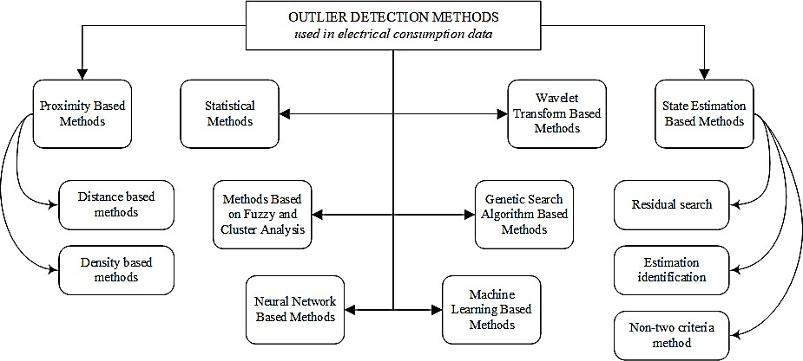
Data detection;

Slide 13
outlier data and missing data
In its most general definition, it is the values that are far from the general data distribution and are statistically inconsistent with other data. Power system transients or malfunctioning in measurement and communication infrastructure may cause outliers. For example, a value of 300kWh in the hourly energy consumption data of a facility with an installed power of 100kW is an outlier.
Missing data are empty or meaningless sections in the data set as the result of problems in the phase of measurement, transfer, or storage processes.
The first step of data cleaning preprocessing is bad data (outlier, noisy data, or missing data) detection. Noisy and missing data can be detected simply but outlier detection is complicated.

Slide 14
Program;
import java.lang.management.ManagementFactory;
import com.sun.management.OperatingSystemMXBean;
public class EnergyConsumptionMonitor {
public static void main(String[] args) {
OperatingSystemMXBean osMBean = (OperatingSystemMXBean) ManagementFactory.getOperatingSystemMXBean();
double cpuUsage = osMBean.getSystemCpuLoad() * 100;
System.out.println("CPU Usage: " + cpuUsage + "%");
}
}

Slide 15
OUTPUT
java - cp / tmp /8U1v8pi9uj
EnergyConsumption moniter
CPU Usage :61 .84773676066042%

Slide 16
Conclusion;
Data science is a very young and rapidly developing field. At the same time, it has a very wide usage area consisting of different disciplines. For these reasons, there is a lot of confusion in both the terminology and the definition and classification of the components. In this study, electricity consumption profile clustering analysis, which is used as the basis of many applications such as short-term demand forecasting, demand management and dynamic tariff planning, has been focused on.
In the first part of the study, data pre-processing steps have been discussed and their applications on electrical energy consumption data has been examined. Studies in the literature have been reviewed and the ones that contain details about the data preprocessing have been taken into account. The data preprocessing steps applied to the electrical energy consumption data and the details of the methods used in the implementation of these steps are presented in tables.

Slide 17
Feature ;
Physical power monitors are the most accurate tools to measure the energy consumed by any device connected to an electric socket. Power monitors are directly connected to the power source of the device and measure the actual power leveraged at any instant of time.

Slide 18
Thank you
By
A.ALLEN PRADHESH

